Slide 1

Geometry
Unit 1, Lesson H1 Symmetries Volume 1, pg. 47

Slide 2


Benchmark
MA.912.GR.2.4
Determine symmetries of reflection, symmetries of rotation, and symmetries of translation of a geometric figure.
volume 1, pg. 47

Slide 3
Integrated Mathematical Thinking and Reasoning Standards
MA.K12.MTR.2.1 Demonstrate understanding by representing problems in multiple ways.
MA.K12.MTR.4.1 Engage in discussions that reflect on the mathematical thinking of self and others.
MA.K12.MTR.5.1 Use patterns and structure to help understand and connect mathematical concepts.
volume 1, pg. 47

Slide 4

Learning Targets
I can determine symmetries of reflection.
I can determine symmetries of rotation.
I can determine symmetries of translation.
volume 1, pg. 47

Slide 5

Warm-Up
volume 1, pg. 48

Slide 6
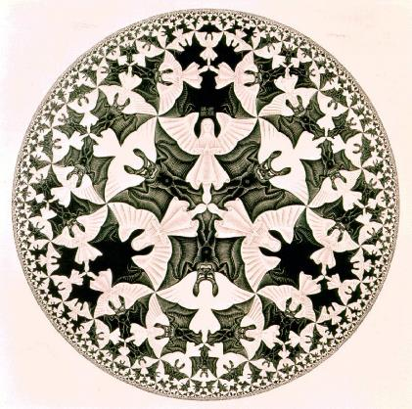
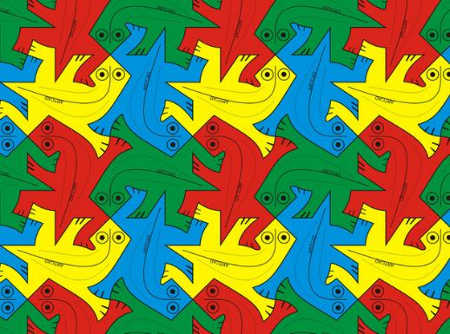
1.H1.1 Warm-Up: Artwork of M.C. Escher
M.C. Escher (1898-1972) was a Dutch artist whose work was inspired by mathematics. Though initially trained as an architect, he became one of the most famous and influential graphic artists in the world.
Below are two examples of Escher’s work.
Example A | Example B
volume 1, pg. 48

Slide 7
Describe any similarities and differences you notice about the two examples.
Similarities | Differences
volume 1, pg. 48

Slide 8

Exploration
volume 1, pg. 48

Slide 9



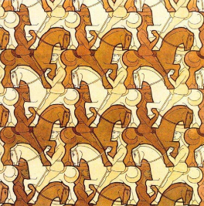
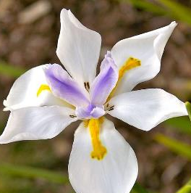
1.H1.2 Exploration: Symmetry
The four images shown below have symmetry.
Discuss with your partner why each image has symmetry and which transformations could be used to show that one part of the image aligns with the other.
Image A | Image B
Image C | Image D
volume 1, pg. 48

Slide 10
Complete the table. Some images may align with more than one type of transformation.
Image | Transformations
A | reflection across a line rotation about a point translation
B | reflection across a line rotation about a point translation
C | reflection across a line rotation about a point translation
D | reflection across a line rotation about a point translation
volume 1, pg. 49

Slide 11
A tessellation is an arrangement of shapes closely fitted together in a repeated pattern without gaps or overlaps.
Which image is a tessellation?
volume 1, pg. 49

Slide 12
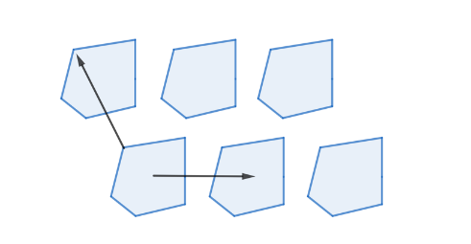
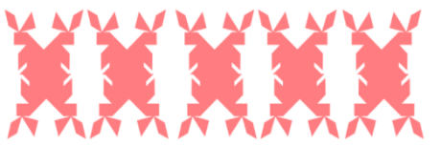
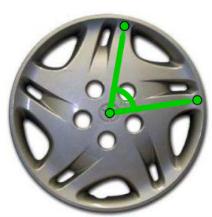
Translational symmetry is when sliding a pattern is used to create symmetry.
Reflectional symmetry is when a pattern can be reflected to create symmetry.
Rotational symmetry is when a rotation can be used to create symmetry. The table shows examples of each type of symmetry.
Image | Symmetry
 | Translational symmetry
 | Reflectional symmetry
 | Rotational symmetry
Micah commented to his partner that he thought the picture for reflectional symmetry could also be translational symmetry. Discuss this with your partner.
volume 1, pg. 49

Slide 13
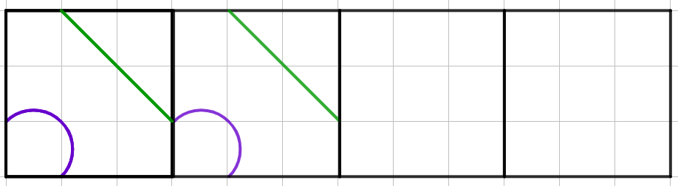
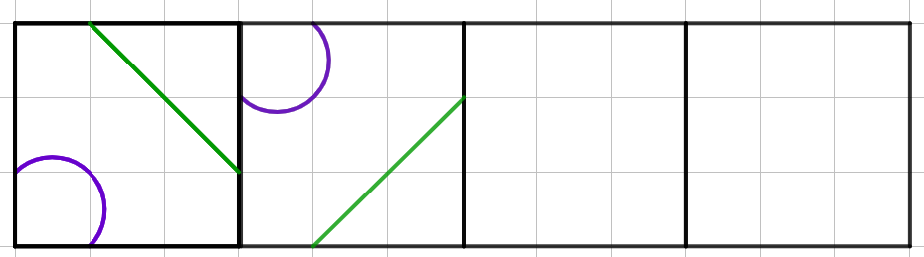
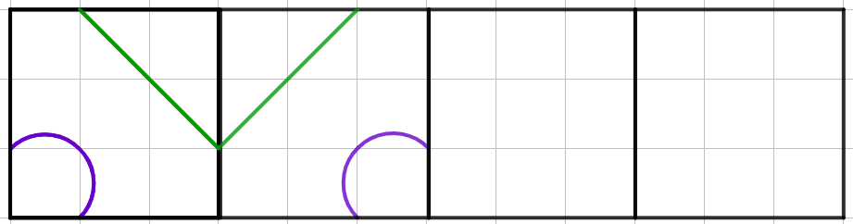
For each pattern, use the first two squares to complete the pattern.
Pattern A
Pattern B
Pattern C
volume 1, pg. 50

Slide 14
Work with your partner to determine the type of symmetry each pattern displays.
Pattern | Type of Symmetry
A
B
C
volume 1, pg. 50

Slide 15
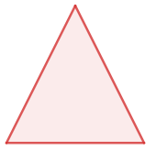
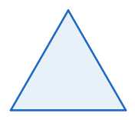
The order of rotational symmetry of a shape is the number of times it can be rotated around a full circle and still look the same.
7. Complete the chart for each polygon.
Polygon | Figure | Number of Lines of Symmetry | Order of Rotational Symmetry
Isosceles triangle
Equilateral triangle
volume 1, pg. 50

Slide 16

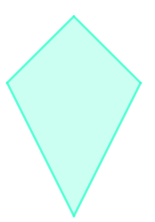
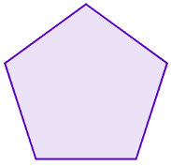
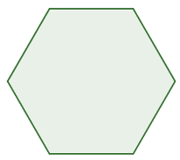
Polygon | Figure | Number of Lines of Symmetry | Order of Rotational Symmetry
Square
Kite
Regular Pentagon
Regular Hexagon
volume 1, pg. 50

Slide 17

Activity
volume 1, pg. 51

Slide 18

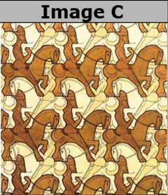
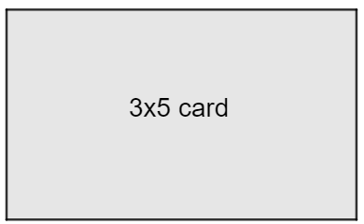
1.H1.3 Activity: Creating a Tessellation
Image C is a tessellation that was created by MC Escher, a famous Dutch artist.
To create a tessellation, you will need a 3x5 index card and tape.
volume 1, pg. 51

Slide 19
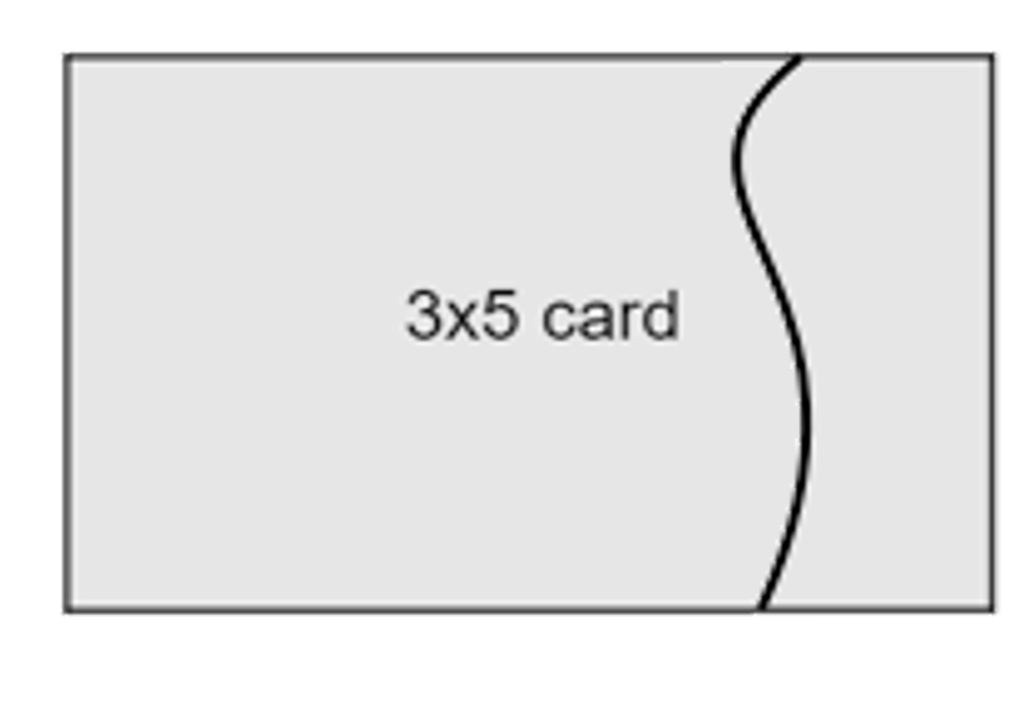
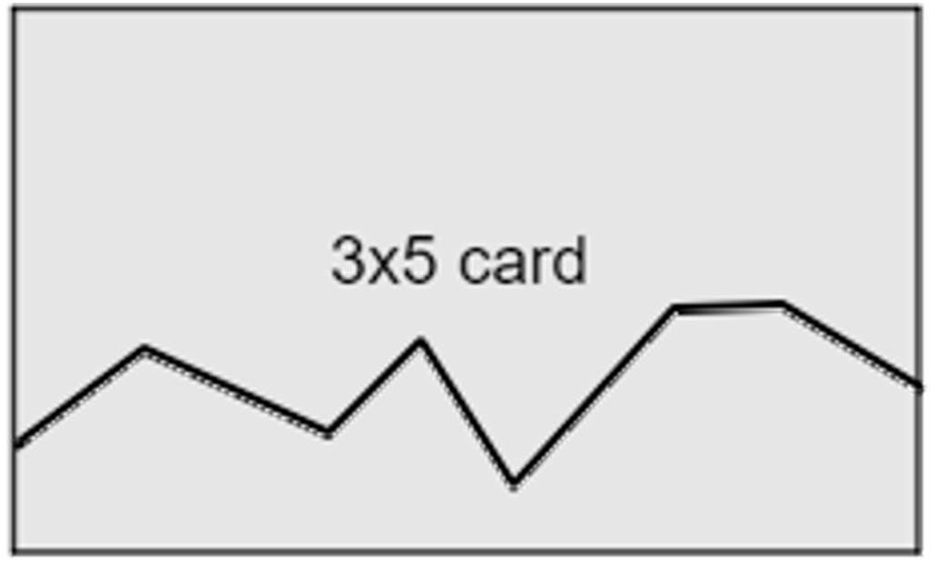
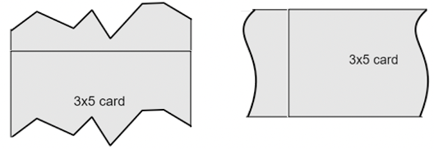
Create your own tessellation by choosing one of the following options. The more cuts you make, the more interesting your pattern will become.
Horizontal Cut
Draw a curve or pattern along a horizontal side of the card.
Vertical Cut
Draw a curve or pattern along a vertical side of the card.
Cut along the curve or pattern and shift the piece to the opposite side.
Tape the piece on.
volume 1, pg. 51

Slide 20
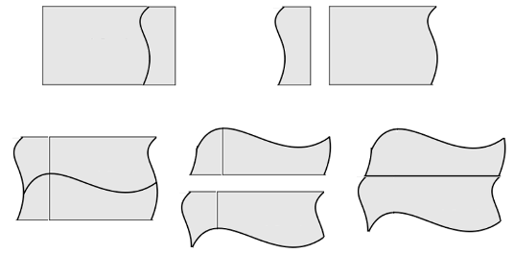
Use your card to create a tessellation by filling up a sheet of paper. Then, color your tessellation.
It is also possible to make multiple cuts as shown.
volume 1, pg. 52

Slide 21

Wrap-Up
volume 1, pg. 52

Slide 22
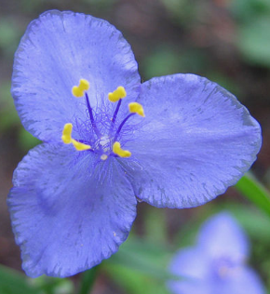
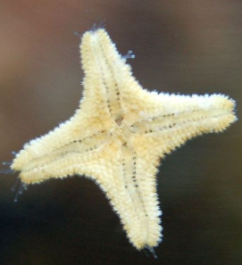
1.H1.4 Wrap-Up: Cool Down
Symmetry is often found in nature. Describe the transformations that show the symmetry of each object.
Image | Object | Transformation
 | Each petal
 | Each arm of the starfish
volume 1, pg. 52

